Slide 1


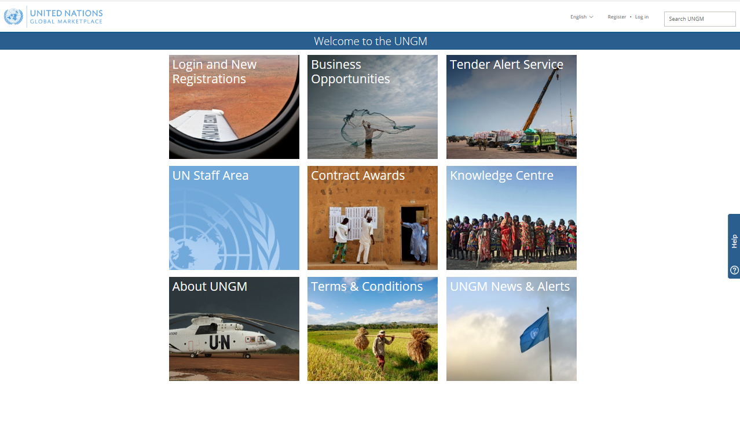
UN Global Marketplace
Procurement portal of the UN system
By Giorgio Fraternale (ILO)

Slide 2

ABOUT UNGM
UNGM is the common procurement portal of the UN system
*
*
UNGM provides an excellent springboard for vendors to introduce their products and services to many UN organizations, countries and regions
Brings together UN procurement staff from 29 UN organizations and potential suppliers from all over the world
UN market:
$18.6 billion in 2017
29 UN organizations use UNGM as their vendor database
98% of the total UN procurement spent

Slide 3
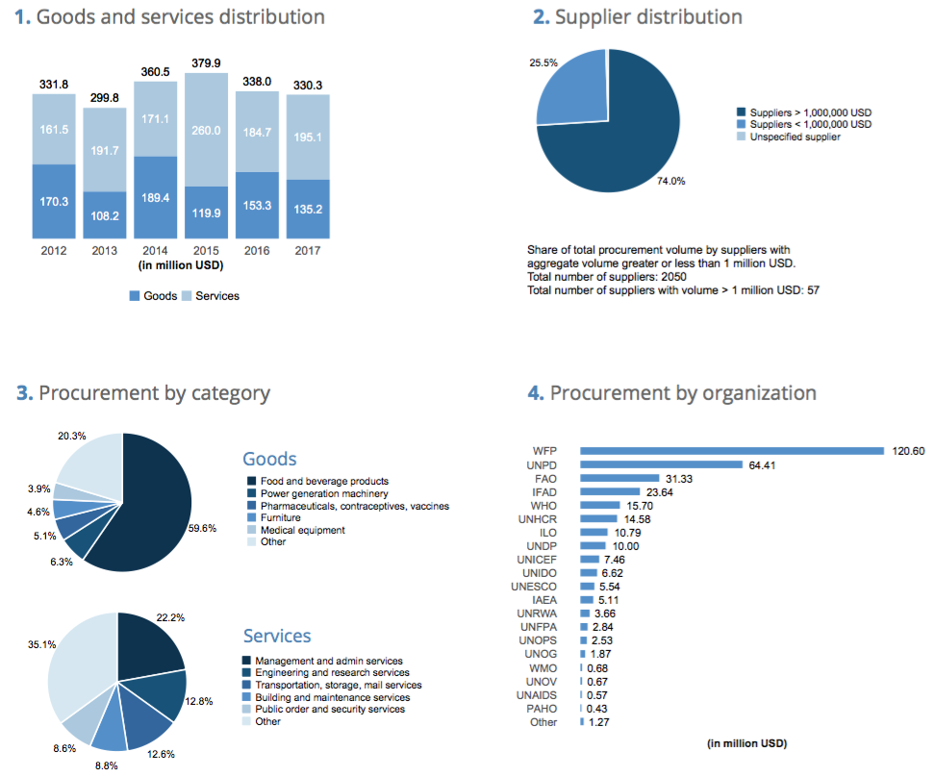
2017 UN PROCUREMENT VOLUME
ITALY
36 different UN organizations procured goods and services from Italy
Procurement volume:
330.31 million USD
Growth over previous year: -2.28%
% of total UN procurement: 1.77%
15th largest country supplier to the UN system

Slide 4
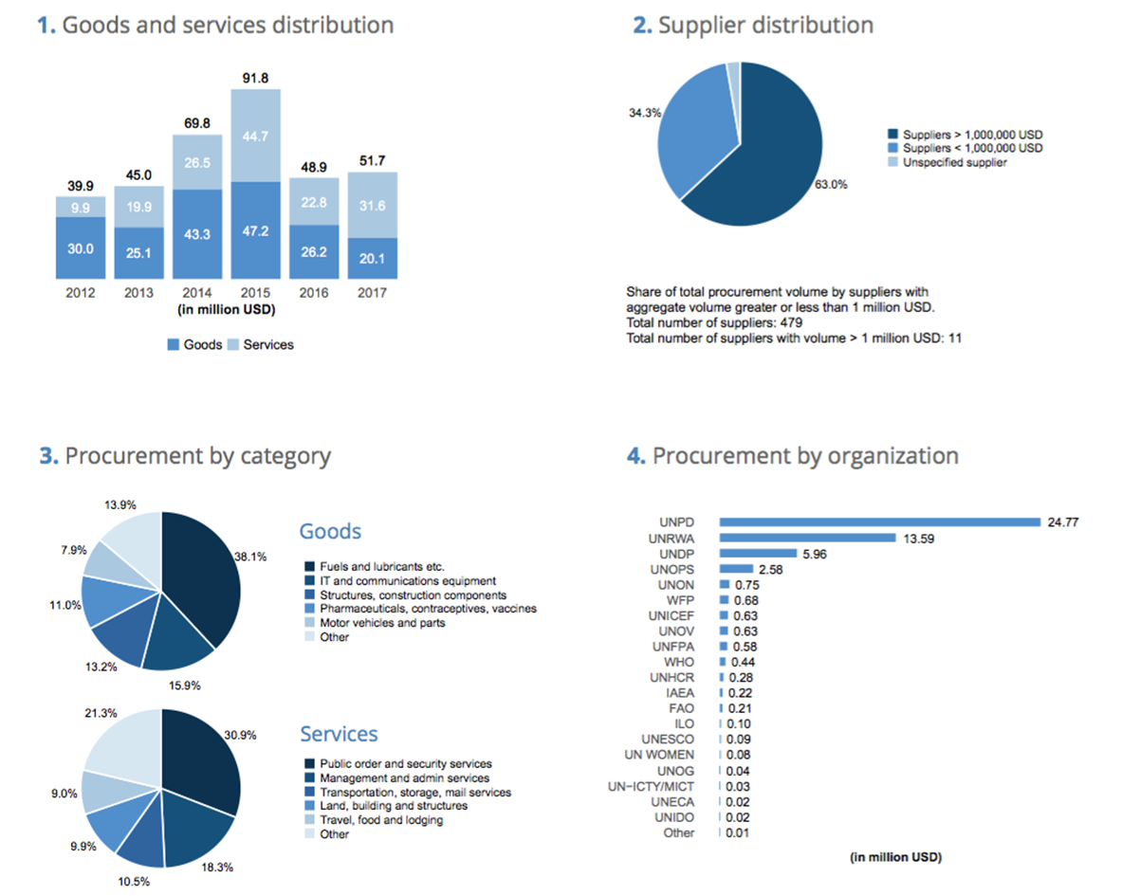
2017 UN PROCUREMENT VOLUME
ISRAEL
23 different UN organizations procured goods and services from Israel
Procurement volume:
51.69 million USD
Growth over previous year:
5.65%
% of total UN procurement: 0.28%
64th largest country supplier to the UN system

Slide 5
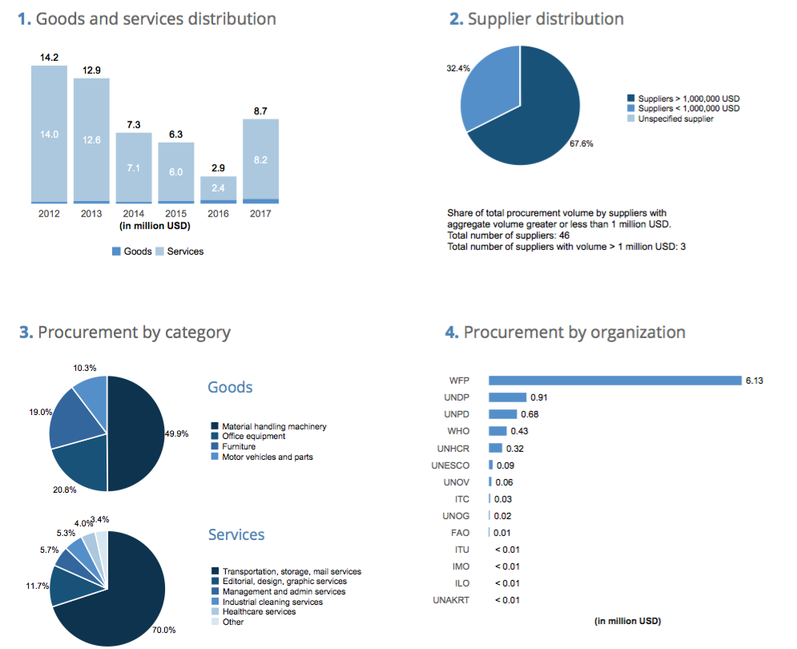
2017 UN PROCUREMENT VOLUME
MALTA
14 different UN organizations procured goods and services from Malta
Procurement volume:
8.69 million USD
Growth over previous year:
203.3%
% of total UN procurement: 0.05%
130th largest country supplier to the UN system

Slide 6
REGISTRATION PROCESS
Free registration
form online
More and more a requirement to participate in tenders
One of first step in doing business with the UN

Slide 7
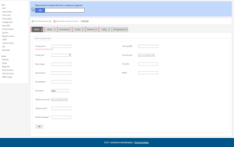
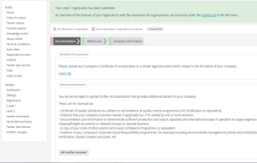
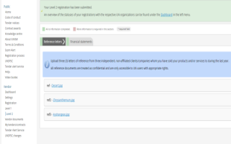
REGISTRATION PROCESS
3 registration levels
  Level is determined by the monetary value of potential contracts
Basic registration
Level 1
Level 2
Common registration process
Some UN organizations require additional information
Registration available in 7 languages

Slide 8

REGISTRATION TIPS & TRICKS
Basic registration
Level 1 & 2
Provide your company name as written in the Certificate of Incorporation
Ensure contact details are up-to-date
Documents are provided in English or are officially translated into English
Ensure the financial documents for the last 3y are provided
Log into your UNGM
account frequently
Information can be checked by UN procurement officers
Notes:
Main point of contact

Slide 9

REGISTRATION STATUSES
Italy Israel Malta
6,297 1,792 166
5,416 1,487 138
881 305 28
496 78 10
120 34 13
Number of accounts created on UNGM
Number of companies ‘registered’ with at least one UN organization
Number of companies NOT visible to any UN organization:
Registration form not completed and not submitted
‘Unmatched’, ‘declined’ and/or ‘vendor to update’ statuses (at basic level)
Number of accounts requiring an update at level 1 and/or 2
Number of companies subscribed to the Tender Alert Service

Slide 10


BUSINESS OPPORTUNITIES
UNGM enables companies to keep abreast of business opportunities
Free access to procurement notices
Published by over 40 UN organizations and entities
Over 500 active notices at any one time

Slide 11

BUSINESS OPPORTUNITIES
UNGM enables companies to be alerted of
relevant business opportunities
Receive latest tenders published on UNGM
Only receive tenders related to your products and/or services
Alerts are sent to your email address
6 months
$175
1 year
$250
2 years
$400
Subscription cost

Slide 12

E-PROCUREMENT SYSTEMS
UNGM is the entry point to UN agencies’
e-procurement systems
12
UNRWA
ITU
UN organizations already have an e-procurement system integrated with UNGM
WHO
ILO
PAHO
IFAD
FAO
WMO
UN Secretariat
5
UNOPS
UNICEF
WTO
additional UN organizations plan to have an e-procurement system integrated with UNGM
UN organizations with integrated systems
Notes:
UN Secretariat, PAHO, FAO, ILO, UNRWA, WMO, WTO, WHO, IFAD, ITU, UNICEF and UNOPS

Slide 13
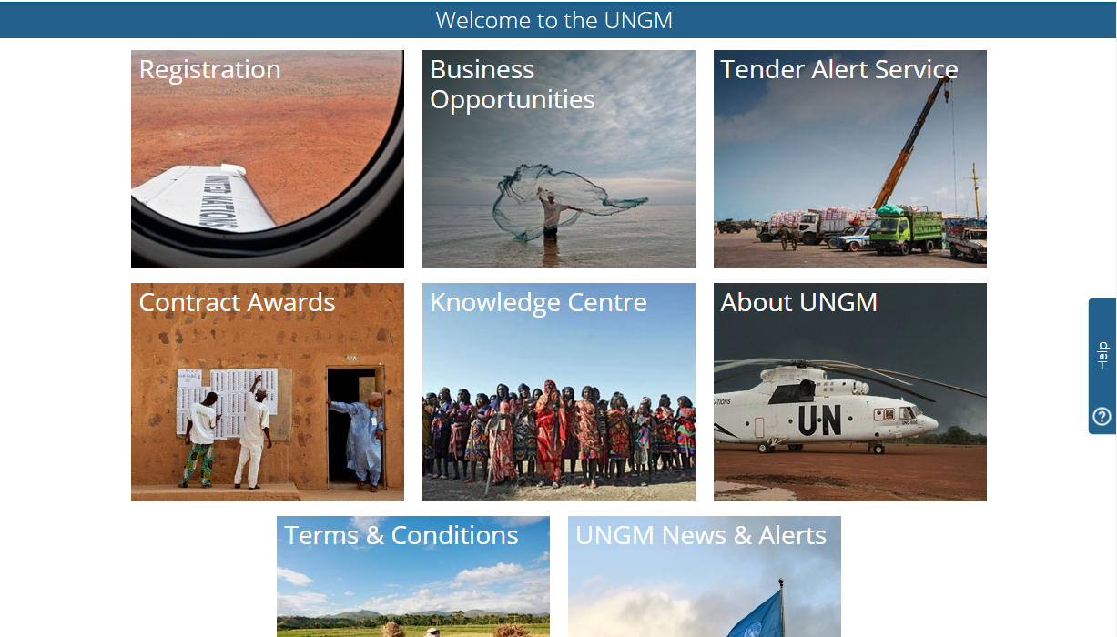
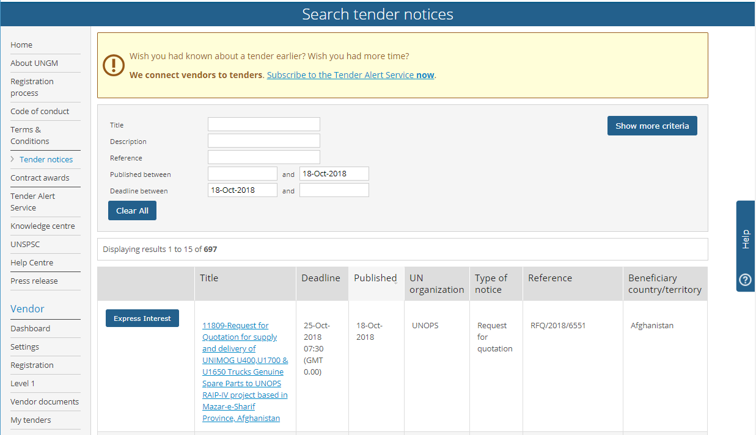
SEARCH TENDER NOTICES
UNGM is the entry point to UN agencies’
e-procurement systems
Click on the ‘Business Opportunities’ box in the UNGM homepage
Access the list of procurement notices publicly available

Slide 14
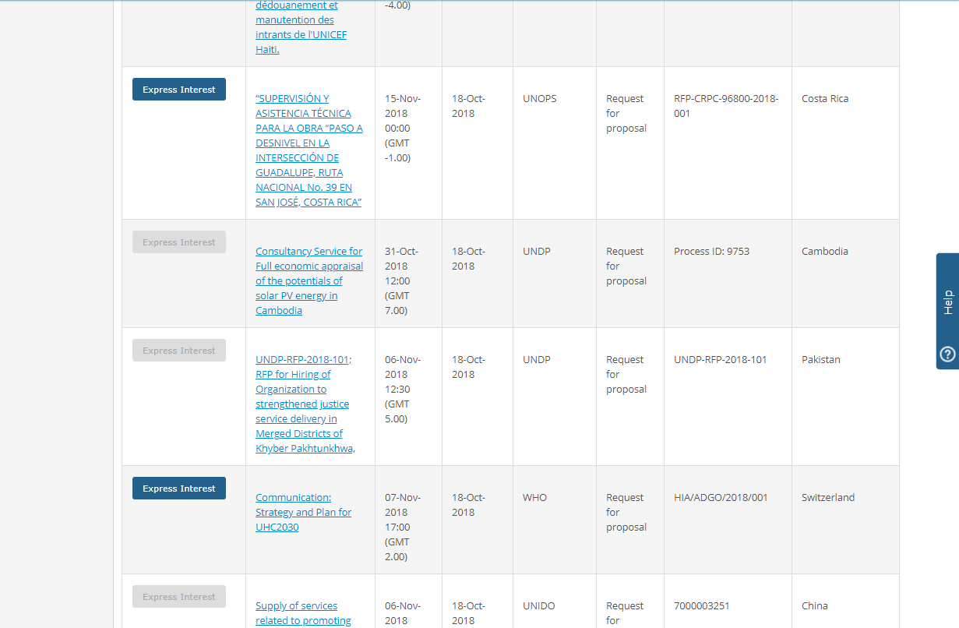
EXPRESS INTEREST
Differentiate between tender notices requiring electronic submission through e-procurement systems and tender notices requiring hard-copy or email submission
Electronic submission through e-procurement systems
Response through traditional methods (hard-copy or email)
OR
Company is not registered with the agency

Slide 15
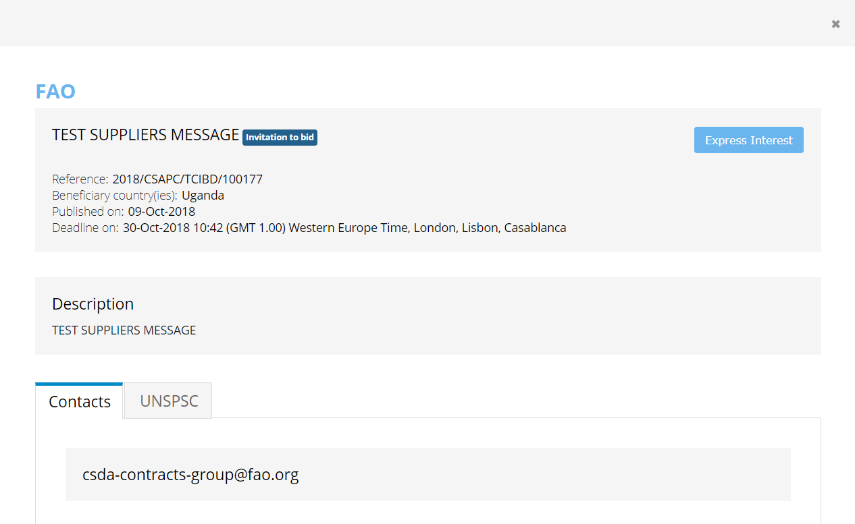
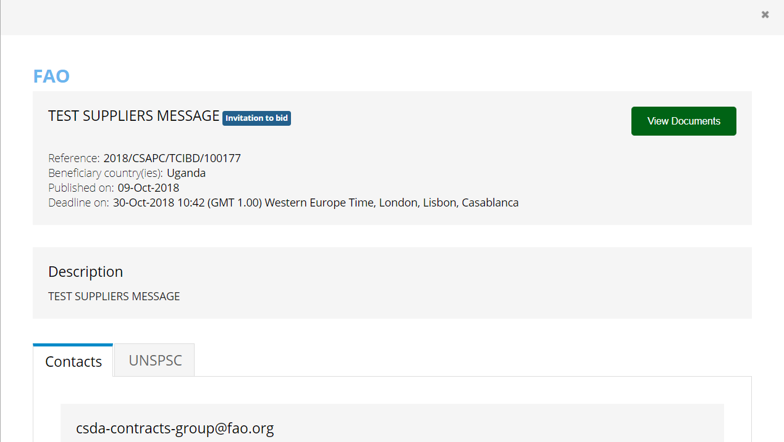
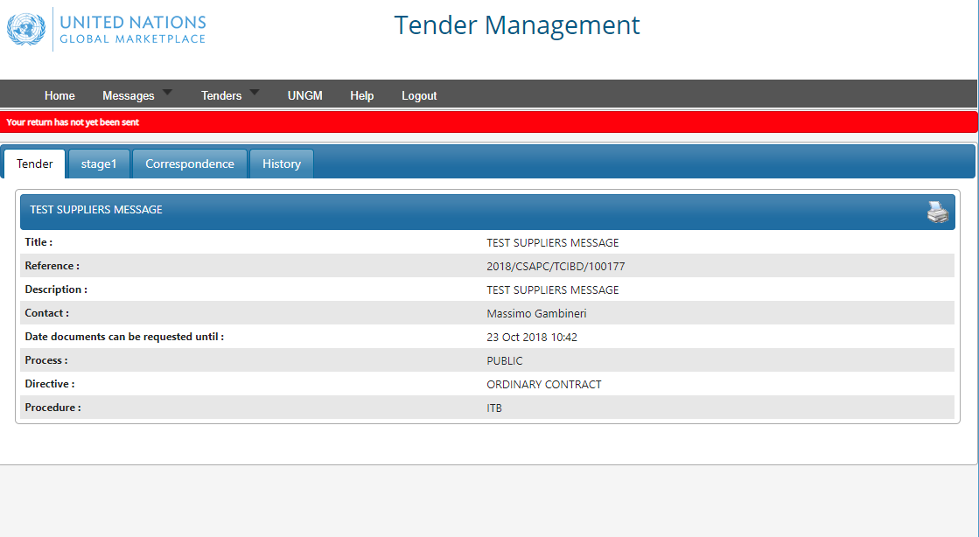
OPEN COMPETITION
Companies must be logged into their UNGM accounts and registered on UNGM with the agency issuing the tender
UNGM
E-procurement
Access tender documentation and submit response under the e-procurement system
Click on the blue ‘express interest’ button available in the notice details
Click on the green ‘View documents’ button to access the e-procurement portal

Slide 16
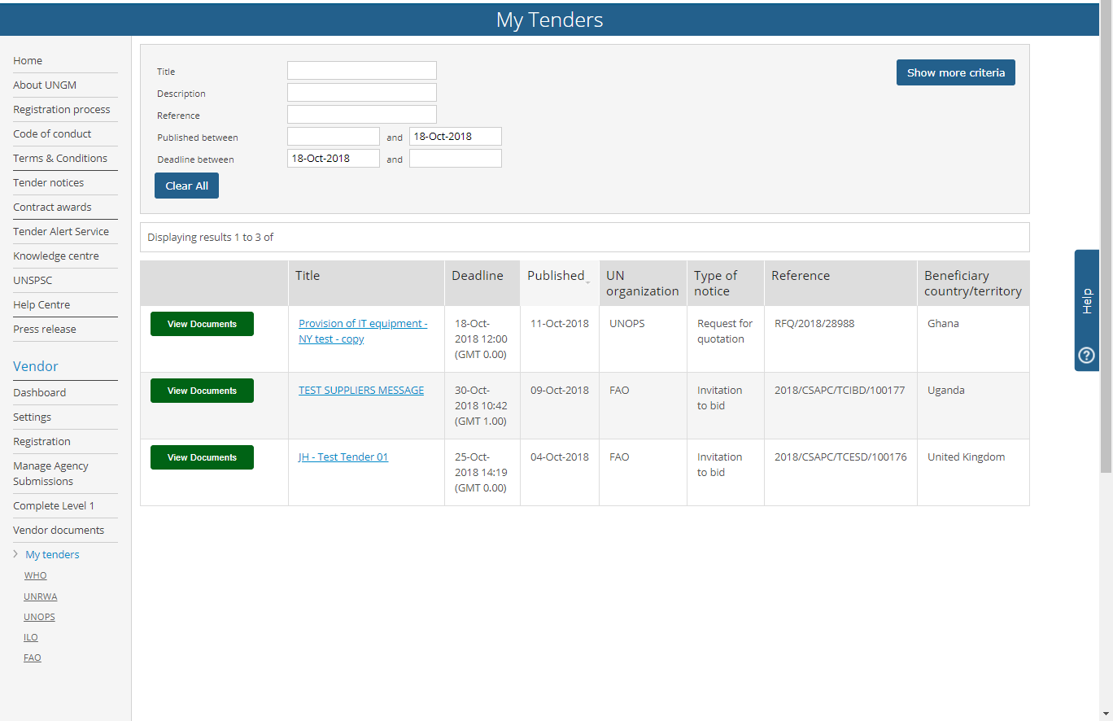
LIMITED COMPETITION
Companies must be logged into their UNGM accounts and registered on UNGM with the agency issuing the tender
UNGM
E-procurement
Go to ‘My tenders’ area in the left-hand menu to identify tenders you have been invited to respond to
Access tender documentation and submit response under the e-procurement system
Click on the green ‘View documents’ button to access the e-procurement portal

Slide 17
TENDER NOTICE FIGURES
2018
9,767 public tender notices published on UNGM
7,036 public tenders published on UNGM via e-procurement
2,676 closed tenders published on e-procurement systems

Slide 18
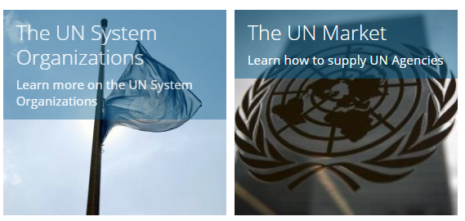
KNOWLEDGE CENTRE
Find useful information on how to start doing business with the United Nations
Information on the United Nations System Organizations:
List of different organizations & agencies and link to websites
UN System organizational chart
Information on the UN market:
Tips for registration on UNGM and for preparing bids/proposals
Information on types of solicitations

Slide 19
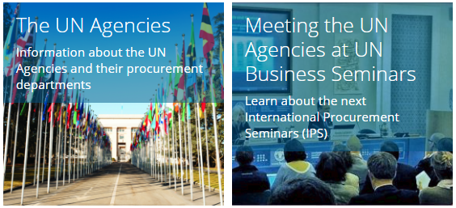
KNOWLEDGE CENTRE
Find useful information on how to start doing business with the United Nations
Details about each UN agencies’ procurement activities:
Description of procurement activities and procedures
Structure of procurement
Major categories purchased
Information on UN business seminars:
Business seminar modalities
Calendar of upcoming seminars
Access to presentations from previous seminars

Slide 20
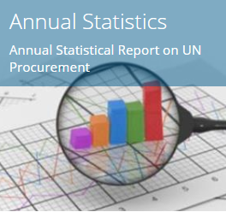
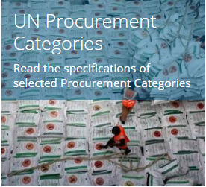
KNOWLEDGE CENTRE
Find useful information on how to start doing business with the United Nations
Find data regarding UN procurement activities:
Download the Annual Statistical Reports on UN procurement
Access an interactive version of the report online
Information on main procurement categories:
Definition of the category and UNSPSC codes
Access to current and past tenders, LTAs and awards
Collection of main specifications

Slide 21
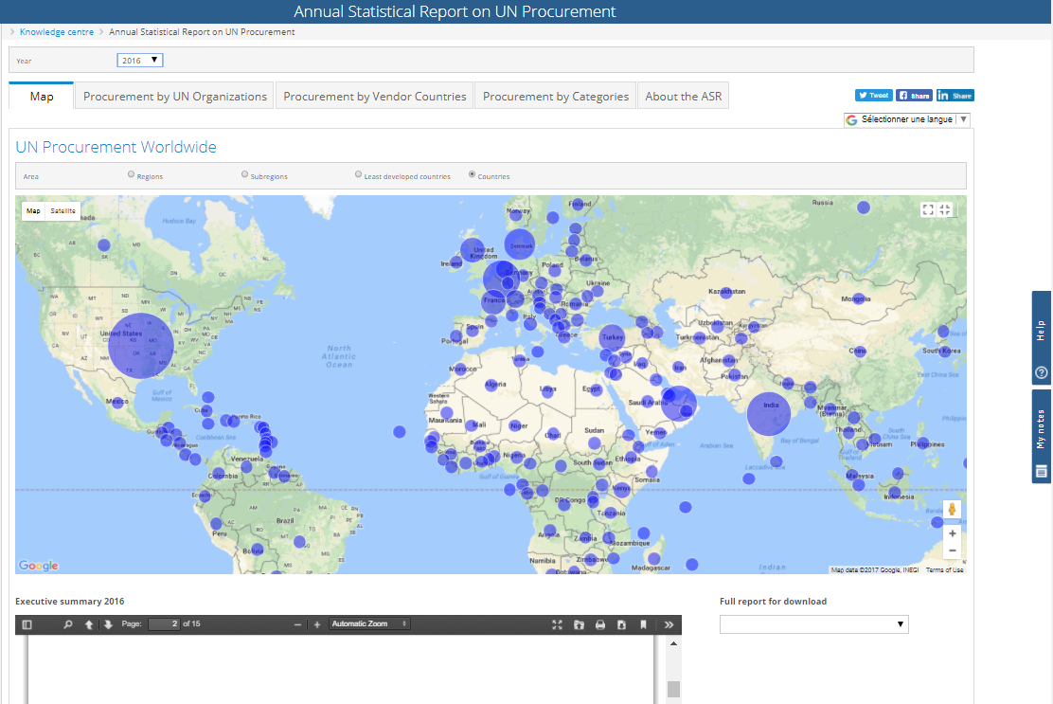
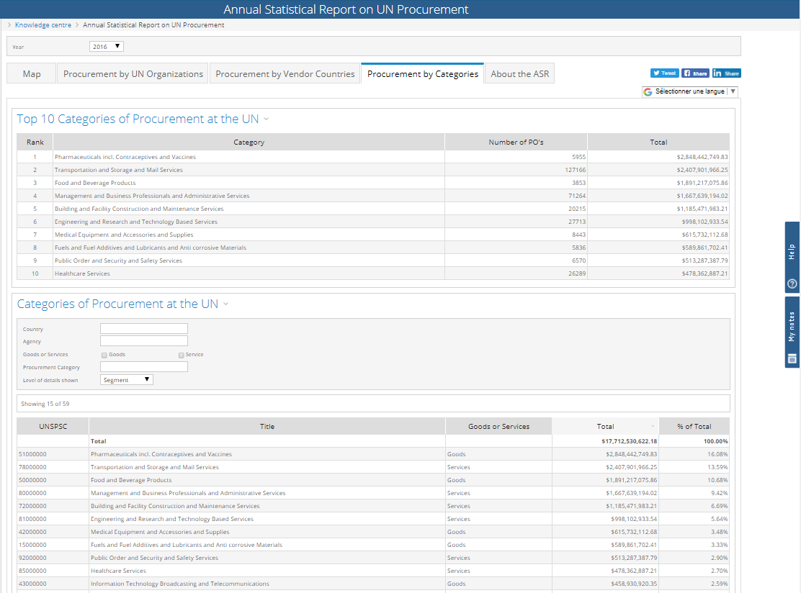
KNOWLEDGE CENTRE
Annual Statistical Report on UN procurement
Geographical visualization of UN procurement volume by:
  Country
  Region
  Sub-region
  Development status
Procurement reports by:
  UN agency
  Country
  Categories of goods or services

Slide 22
TO SUMMARIZE
1
Register your company on UNGM and ensure that your company’s details and contact details are updated
Familiarize yourself with the different UN agencies’
procurement needs and procedures
Check regularly procurement notices on UNGM or subscribe to the Tender Alert Service
2
3
THANK YOU
www.ungm.org
registry@ungm.org

