Slide 1

UNGM - United Nations Global Marketplace
What is the United Nations Global Marketplace (UNGM)?
UNGM is the common vendor database for the UN system. It brings together UN procurement staff and potential suppliers of a diverse range of products and services from all over the world.
The UNGM acts as a single window, through which potential vendors may register with any of the 29 UN organizations using the UNGM as their vendor database. These organizations account for over 99% of the total UN procurement spent.
The UNGM therefore provides an excellent springboard for vendors to introduce their products and services to many UN organizations, countries and regions by completing only one registration form.
FUNCTIONALITIES
Registration process
The registration on UNGM is a requirement to participate in tenders from more and more UN organizations.
The registration on UNGM is free of charge and is available for companies and Individual Consultants.
There are three registration levels but only the basic level is mandatory. It takes approximately 5 to 10 min to complete this registration level.
The supplier needs to create an account, complete a registration form and submit it to the agencies matching the company’s profile.
Knowledge Centre
UNGM has recently launched its new Knowledge Centre.
This new interactive platform has been designed to provide suppliers and users with useful information on how to start doing business with the United Nations.
Business opportunities
UNGM enables companies to keep abreast of business opportunities. At any given time, there are over 500 active notices available free of charge on the site published by more than 40 UN organizations and entities.
A number of procurement notices published on UNGM are published through web services which are fully integrated with UNGM.
Some UN organizations also integrate their vendor roster with e-tendering platforms. Suppliers can express interest directly through the portal and receive tender documents automatically.
Tender Alert Service
The UNGM website offers an optional service to suppliers who would like to receive the latest and most relevant business opportunities by email.
This service costs USD 250 per year.

Slide 2



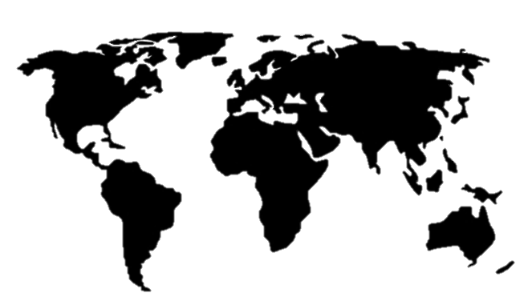

SUPPORTING ORGANIZATIONS
29 UN organizations maintain a vendor roster on UNGM
17 UN organizations have or plan an ERP and/or e-procurement integration
4,233
tender notices have been published on UNGM in 2019 (1 May 2019)
UNGM VISITORS
431,564
users
have visited the UNGM website in 2019
UNGM attracted 38% of new users in 2019
In 2019, the majority of new users came from Europe and the Americas
UNGM users are mainly located in Asia and Europe
VENDOR REGISTRATION ON UNGM
206,676
SUPPLIERS ARE CURRENTLY REGISTERED ON UNGM (1 May 2019)
+503%
The percentage increase of registered vendors since the launch of the new UNGM in November 2013
21,396
SUPPLIERS HAVE REGISTERED ON UNGM IN 2019 (1 May 2019)

Slide 3
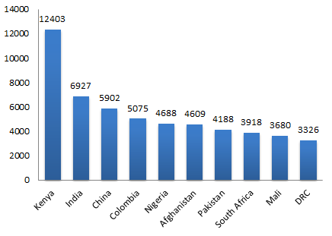
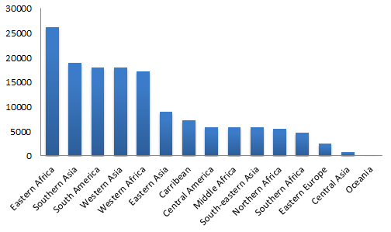
SUPPLIERS FROM DEVELOPING COUNTRIES & ECONOMIES IN TRANSITION
136,310
SUPPLIERS FROM DEVELOPING COUNTRIES AND ECONOMIES
IN TRANSITION ARE CURRENTLY REGISTERED ON UNGM (1 May 2019)
+617%
The percentage increase of registered vendors from developing countries and economies in transition since the launch of the new UNGM in November 2013
The number of suppliers from developing countries and economies in transition represents 70% of the total number of registered suppliers on UNGM
TOP 10 DEVELOPING COUNTRIES & ECONOMIES IN TRANSITION IN TERMS OF SUPPLIER REGISTRATIONS ON UNGM
GEOGRAPHICAL DISTRIBUTION OF SUPPLIERS FROM DEVELOPING COUNTRIES AND COUNTRIES WITH ECONOMIES IN TRANSITION PER SUB-CONTINENT
The majority of suppliers registered on UNGM from developing countries and countries with economies in transition are based in Africa (Eastern, Western Africa) and Asia (Western Asia, Southern Asia and Eastern Asia)

Slide 4
STATUS OF ITALIAN COMPANIES REGISTERED ON UNGM
6297
ITALIAN COMPANIES HAVE CREATED AN ACCOUNT ON UNGM
5416
ITALIAN COMPANIES ARE CURRENTLY
REGISTERED AT BASIC LEVEL WITH
AT LEAST ONE AGENCY
=
0.2%
of total number of companies registered on UNGM
881
ITALIAN COMPANIES ARE NOT VISIBLE TO ANY UN ORGANIZATION
because:
the registration was not completed or submitted
830
ITALIAN COMPANIES ARE REGISTERED AT THE LEVEL 1 AND/OR 2
496
ITALIAN COMPANIES NEED TO UPDATE INFORMATION IN THE LEVEL 1 AND/OR LEVEL 2 REGISTRATIONS
120
ITALIAN COMPANIES HAVE ACTIVE TENDER ALERT SERVICE

Slide 5
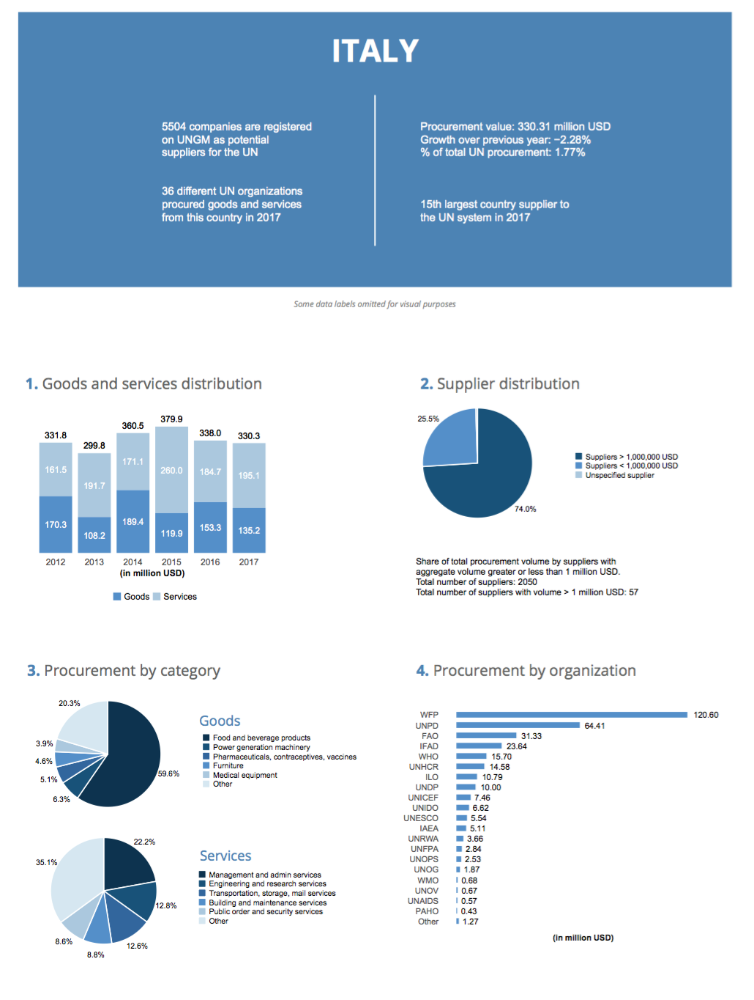
ITALY: 2017 UN PROCUREMENT VOLUME
Source: Annual Statistical Report on UN Procurement 2017/ https://www.ungm.org/Public/ASR

Slide 6
STATUS OF ISRAELI COMPANIES REGISTERED ON UNGM
1792
ISRAELI COMPANIES HAVE CREATED AN ACCOUNT ON UNGM
1487
ISRAELI COMPANIES ARE CURRENTLY
REGISTERED AT BASIC LEVEL WITH
AT LEAST ONE AGENCY
=
0.07%
of total number of companies registered on UNGM
305
ISRAELI COMPANIES ARE NOT VISIBLE TO ANY UN ORGANIZATION
because:
the registration was not completed or submitted
208
ISRAELI COMPANIES ARE REGISTERED AT THE LEVEL 1 AND/OR 2
78
ISRAELI COMPANIES NEED TO UPDATE INFORMATION IN THE LEVEL 1 AND/OR LEVEL 2 REGISTRATIONS
34
ISRAELI COMPANIES HAVE ACTIVE TENDER ALERT SERVICE

Slide 7
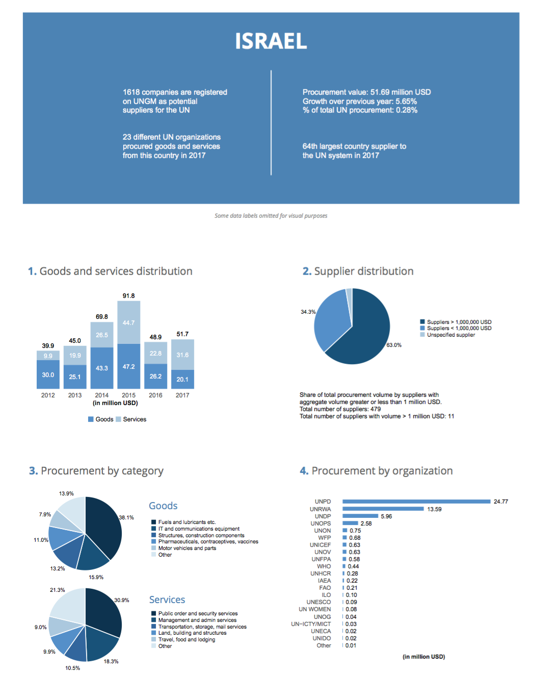
ISRAEL: 2017 UN PROCUREMENT VOLUME
Source: Annual Statistical Report on UN Procurement 2017/ https://www.ungm.org/Public/ASR

Slide 8
STATUS OF COMPANIES FROM MALTA REGISTERED ON UNGM
166
COMPANIES FROM MALTA HAVE CREATED AN ACCOUNT ON UNGM
138
COMPANIES FROM MALTA ARE CURRENTLY
REGISTERED AT BASIC LEVEL WITH
AT LEAST ONE AGENCY
=
0.007%
of total number of companies registered on UNGM
28
COMPANIES FROM MALTA ARE NOT VISIBLE TO ANY UN ORGANIZATION
because:
the registration was not completed or submitted
26
COMPANIES FROM MALTA ARE REGISTERED AT THE LEVEL 1 AND/OR 2
10
COMPANIES FROM MALTA NEED TO UPDATE INFORMATION IN THE LEVEL 1 AND/OR LEVEL 2 REGISTRATIONS
13
COMPANIES FROM MALTA HAVE ACTIVE TENDER ALERT SERVICE

Slide 9
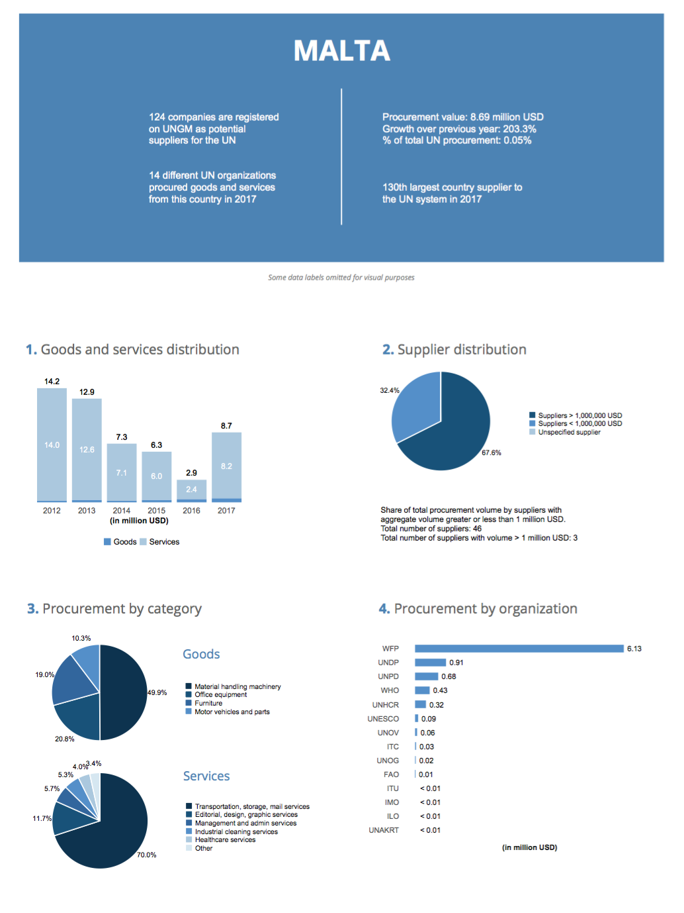
MALTA: 2017 UN PROCUREMENT VOLUME
Source: Annual Statistical Report on UN Procurement 2017/ https://www.ungm.org/Public/ASR

