Slide 1
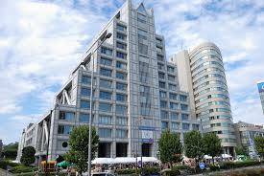

UN University- Procurement

Slide 2
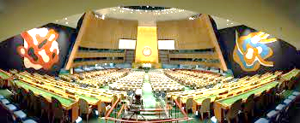
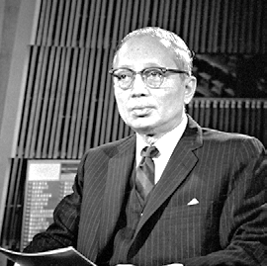
Establishment of the UNU
The United Nations General Assembly, on its 27th session on 11 Dec 1972, approved the establishment of the UNU (resolution 2951 (XXVII)).

Slide 3


Mandate of the UNU
The UNU is a global think tank and postgraduate teaching organization
Works with leading universities and research institutes in UN Member States
Functions as a bridge between the international academic community and the UN system.

Slide 4
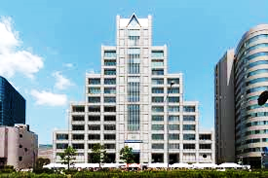
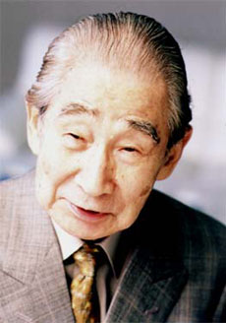
Headquarters of the UNU
The UNU Headquarters is located in Tokyo
The iconic building was provided by the Ministry of Education, Culture, Sports, Science and Technology of Japan and handed over to the UNU in 1992
It was designed by Dr. Kenzo Tange Kenzō Tange (丹下 健三) winner of the 1987 Pritzker Prize for architecture .

Slide 5

UNU Institutes
The UNU encompasses 13 institutes in 12 countries around the world
UNU-CRIS, Bruges
ana
UNU FTP, Reykjavík
UNU-INWEH, Hamilton
UNU-INRA, Accra
UNU-EHS, Bonn
UNU-FLORES, Dresden
UNU-CS
Macau
UNU-WIDER, Helsinki
UNU-IIGH, Kuala Lumpur
UNU-BIOLAC, Caracas
UNU-EGOV, Guinaraes
UNU-MERIT, Maastricht
UNU-GCM, Barcelona

Slide 6
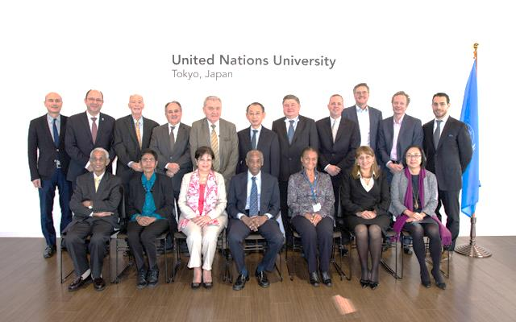
UNU Leadership
The UNU Council serves as the governing board of the UNU
Responsible for devising the principles and policies that govern the UNU’s operations, and for considering and approving the UNU budget and work programme.

Slide 7
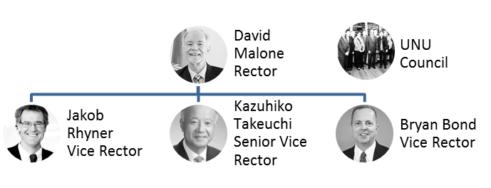
The Rector is the chief academic and administrative ofﬁcer of UNU. He is assisted by 3 Vice-Rectors, 2 based in Tokyo and 1 at the UNU Vice-Rectorate in Europe, in Bonn.

Slide 8
UNU Personnel
The UNU has approximately 480 staff worldwide, 35% were developing country nationals and 44% were women.

Slide 9
Procurement Expenditure
The goods and services usually procured by the UNU are as follows:.
 | Goods/Services Procured |  | Amount (%)
1 | Air Tickets |  | 29%
2 | Building services |  | 26%
3 | Leasehold improvement |  | 16%
4 | IT & Communications Equipment |  | 14%
5 | Printing & publishing, film production |  | 10%
6 | Conference Services |  | 9%
7 | Furniture & Fittings |  | 6%
8 | Rental building |  | 5%
9 | Operational & finance lease |  | 5%
10 | Office equipment & services |  | 7%
11 | Employee services |  | 2%
12 | Other |  | 1%

Slide 10
Procurement Methods
The following are procurement methods used in the UNU:
Direct Contracting
(for procurement expenditure below US$4,000)
Request for Quotation (RFQ) (for procurement expenditure between $4,000 to $40,000)
Invitation for Bid (ITB)
(for procurement expenditure above $40,000)
Applies to standard and/or quantifiable deliverables
Request for Proposal (RFP)
(for procurement expenditure above $40,000)
Applies to complex and/or non-quantifiable deliverables

Slide 11
Procurement Process (RFP/ITB)
UNU advertises Request for Expression of Interest (REOI)
Interested bidders submit Vendor Response Forms
UNU sends solicitation documents to interested bidders
Bidders confirm intention to participate
Questions and Answers
Bidders submit bid proposal before closing deadline
Bidders attend public bid opening
UNU conducts evaluation of bid proposals
UNU issues notice of award
Contract is finalized/issued
Contractor delivers goods
Contractor issues invoice
UNU issues payment
UNU confirms satisfactory receipt
Bidders attend pre-offer conference

Slide 12
To ensure procurement integrity and transparency, contracts are approved (and independently reviewed as required) in the following manner:
United Nations Procurement Division, UN Secretariat (New York)
(for contracts more than $200,000)
UNU Director of Admin.
(for contracts up to $200,000)
UNU Staff with sub-delegated procurement authority (for contracts up to $75,000)
Headquarters Committee for Contracts review
(for contracts more than US $500,000)
Local Committee for Contracts review (for contracts more than US $75,000)

Slide 13
UNU’s top 20 vendors worldwide are as follows
 | Name | Country
1 | Sanko Inc. | Japan
2 | Lilycolor Co. Ltd | Japan
3 | First Card | Finland
4 | BELVEDERE WIJKONTWIKKELINGSMAATSCHAPPIJ | Netherlands
5 | GREENHEART TOURS, INC. | Japan
6 | United Victory International Limited | Macau
7 | Westtours-Reisen GmbH | Germany
8 | Propeople GmbH | Germany
9 | Scandic Hotels Oy | Finland
10 | Diners World Travel (M) Sdn Bhd | Malaysia
11 | McMaster Innovation Park | Canada
12 | SOONS INTERIEURBOUW BV | Netherlands
13 | Nissin Travel Service Co., Ltd. | Japan
14 | Regency Travel Consultants Inc. | Canada
15 | Cigna International Health Services BVBA | Belgium
16 | GlobalTrot Travel | Ghana
17 | Aiyu Travel Planner | Japan
18 | Obs Arquitectos Lda | Macau
19 | Fuji Xerox Co., Ltd | Japan
20 | Japan Business Systems Inc. | Japan

Slide 14
UNU Vendors’ geographical locations are as follows:
*USA, UK, Canada, Malaysia, Belgium, Kenya, Spain, Portugal, Sweden, Denmark, Ghana, Luxembourg, France, Mexico, India, Switzerland, Ethiopia, Hong Kong, Singapore, China, South Africa, Australia

Slide 15
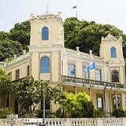


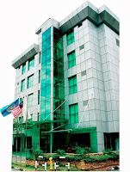


Thank you

