Slide 1

  World Food Programme
  Introducing WFP procurement
  February 2016

Slide 2
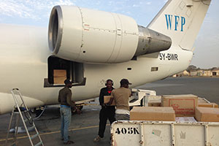

WFP Procurement
The World Food Programme provides food assistance to meet emergency needs and to support economic and social development.
.
WFP aims to bring food assistance to more than 90 million people in 75 countries
In 2015, WFP procured over 2.5 billion of food, goods and services to support the distribution of approx. 4-5 million metric tons of food.

Slide 3
WFP Procurement in 2015
TOTAL:
USD 2.63 billion
Goods and Services
USD 587 million
Logistics
USD 974 million
Food
USD 1.07 billion

Slide 4

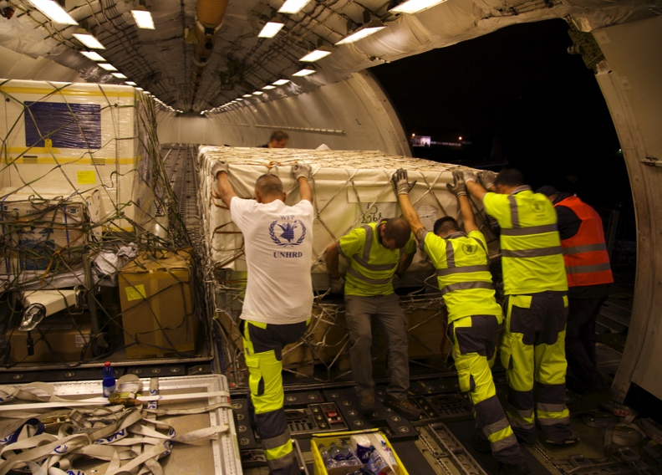
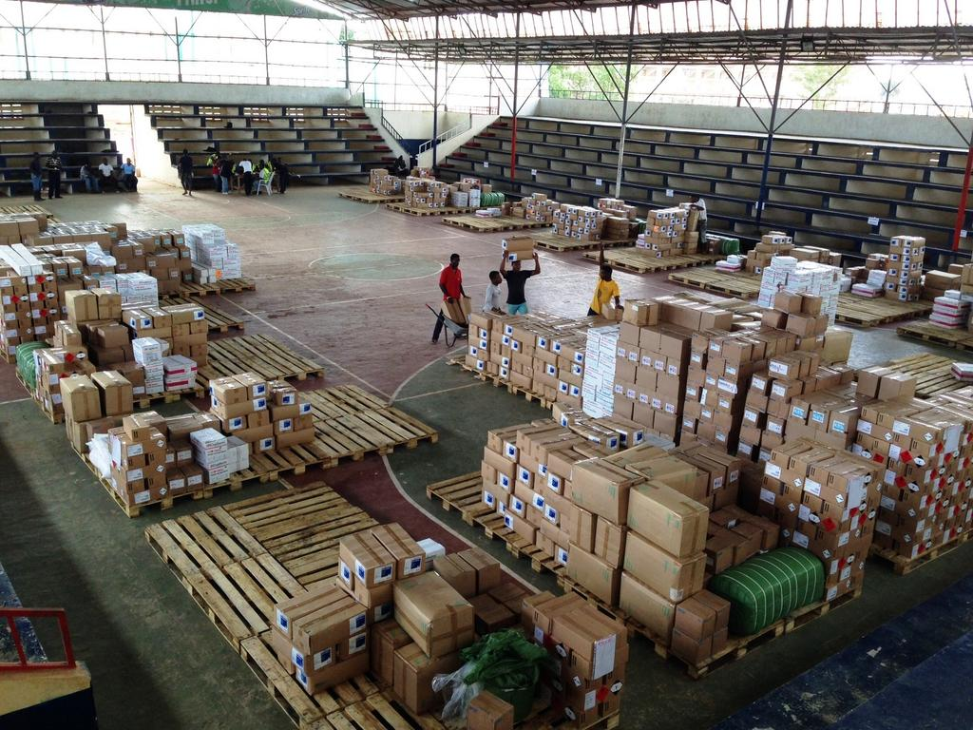
Goods & Services (G&S) Procurement

Slide 5
G&S Procurement
Contracts with commercial providers are managed by WFP’s Goods & Services Procurement Branch*.
  Headquarters at Rome, Italy
  Regional Bureaux at 5 locations worldwide
  Field Offices in 80 countries worldwide
G&S Procurement has always been a core functional area within WFP. Since 2004 the volume of G&S procurement by value has grown by 200%
The G&S Procurement branch procures on behalf of WFP, however, some linked structures like UNHRD also procure on behalf of the wider UN and governmental/non-governmental agencies.
*with the exception of warehouse leasing, fleet management, shipping & contracting of air assets covered by WFP logistics

Slide 6
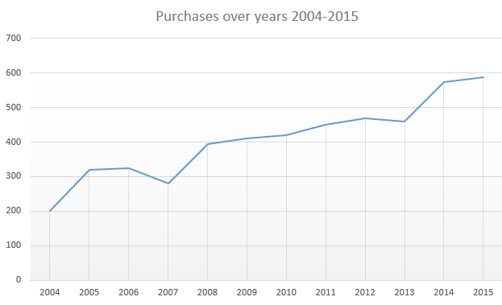
G&S Procurement – Historic Trend
In 2015 WFP Procurement purchased $587m of G&S.
Value
$m
Year

Slide 7
G&S Procurement – Key Role
Four Principal Functions
Oversee & manage large value G&S field procurement
Undertake all G&S procurement at WFP headquarters.
Manage all policy guidance and support to WFP offices worldwide;
Engage with external clients, when WFP commits to procure on behalf of other UN Agencies/other actors.
Ensure all G&S procurement is undertaken in a consistent, cost effective and transparent manner respecting the guiding principles of UN procurement.
Provide procurement expertise to external actors, as required

Slide 8
G&S Procurement - Key categories
Fuel, in particular Jet-A1
Construction
ICT
Consultancy services
Vehicles
GOODS
USD 278m (47%)
SERVICES
USD 309m (53%)

Slide 9
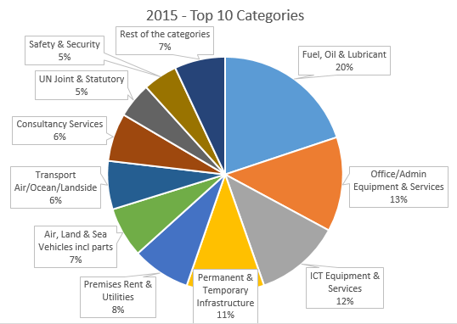

G&S Procurement – Key Categories

Slide 10
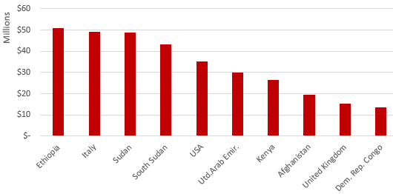
G&S Procurement – Main Vendor Countries 2015
Top 10 Vendor countries

Slide 11
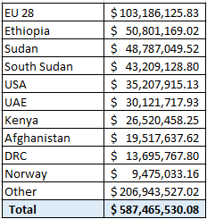
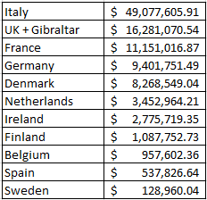
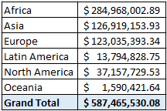
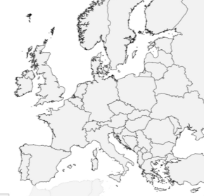
Goods & Services procurement from EU countries 2015
Top 10 Vendor countries
Top 10 EU vendor countries
By continent

Slide 12
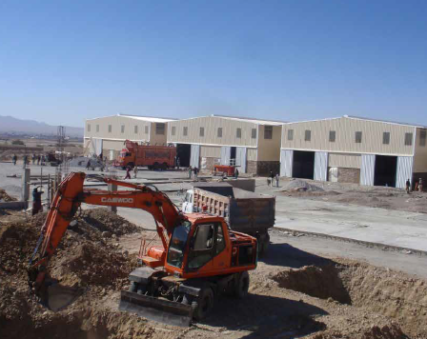
G&S Procurement – Construction
Construction was 10.7% of WFP’s Goods and Services budget in 2015
Construction accounts for the third-largest
goods and services spending category. WFP uses
its in-house expertise in the areas of logistics,
procurement and engineering to successfully
carry out numerous construction projects
around the globe.
This involves building roads, bridges,
airstrips and ports, offices, guesthouses,
warehouses, schools and camps.
WFP undertakes construction to support
the longer-term needs of national
governments, the humanitarian community
and WFP’s own operations. Projects vary
in scale and complexity depending on their
location, the local context, and scope.

Slide 13
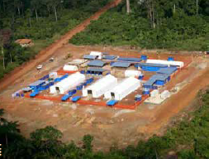
WFP Construction
In response to the unprecedented scale of the Ebola Virus Disease outbreak in West Africa, WFP was heavily involved in the procurement of goods and services to support the emergency response.
To assist the wider humanitarian community, the organization made first-time purchases of ambulances, treatment units, incinerators and medical beds - items specific to the large scale health response.
These items required Procurement to undertake rapid market assessments and identify suppliers that could quickly fulfil orders to meet specifications. Due to the urgent timelines, WFP often made special arrangements for the transport of goods, including airlifting items when required
to shorten delivery time.
WFP Ebola response entailed more than 35.5 million USD (2014 and 2015)

Slide 14
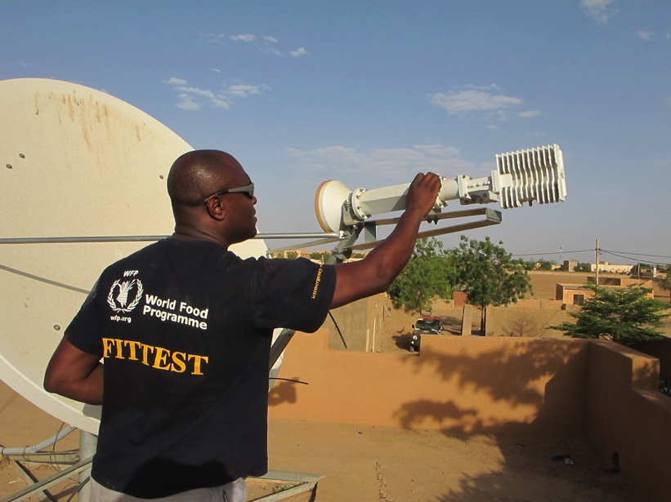
ICT – Corporate IT & FITTEST
WFP’s IT Division at its Rome Headquarters is responsible for the establishment, implementation and governance of WFP’s IT strategy worldwide. It is supported by IT officers at Regional Bureaux and in WFP Field Offices.
  In addition, WFP’s Fast IT and Telecommunications Emergency Support Team (FITTEST) is a leader in establishing vital IT and communications infrastructure during emergencies.
  WFP is the UN cluster lead for Emergency Telecommunications. FITTEST operates within the cluster.
In 2015 WFP’s ICT expenditure exceeded $70m

Slide 15

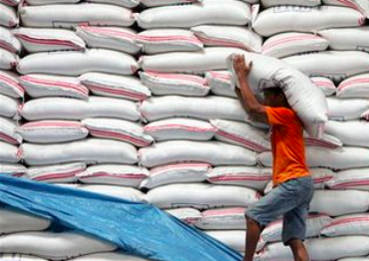

Food Procurement

Slide 16
Food Procurement – Key Role
Undertake all international food procurement for all WFP operations worldwide as well as for third parties such as UN Agencies, Governments and NGOs;
Provide oversight, technical expertize and guidance to all WFP offices to ensure that food procurement is undertaken in a cost effective, timely and transparent manner;
Support the development and implementation of strategies, policies and plans to meet WFP’s mandate
Review and authorize all food procurement actions from the field above the authority of field offices

Slide 17
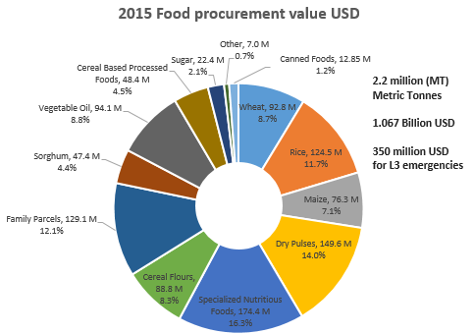
Food Procurement - 2015

Slide 18
Food Procurement – Conditions
Conditions affecting food procurement
Donor country conditions/restrictions
(origin/ destination/quality /packing /marking etc.)
Recipient country requirements
(product/origin/packing/import regulations)
Impact on local market/economy
(harvest/lean period/surplus)

Slide 19
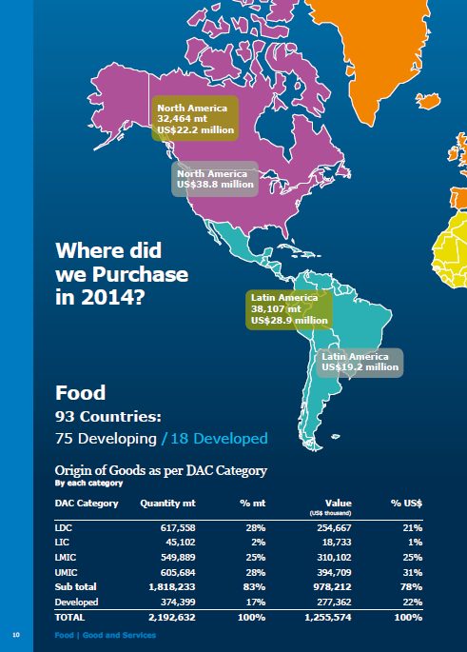
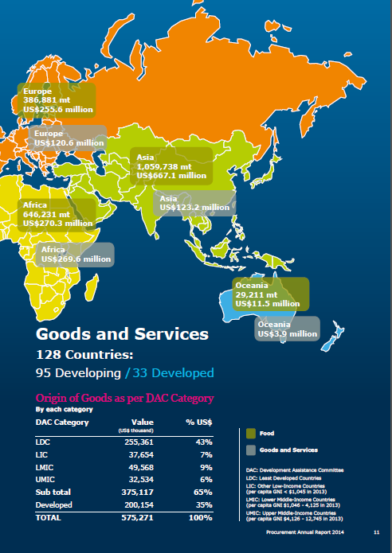

Slide 20
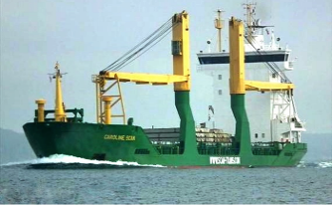
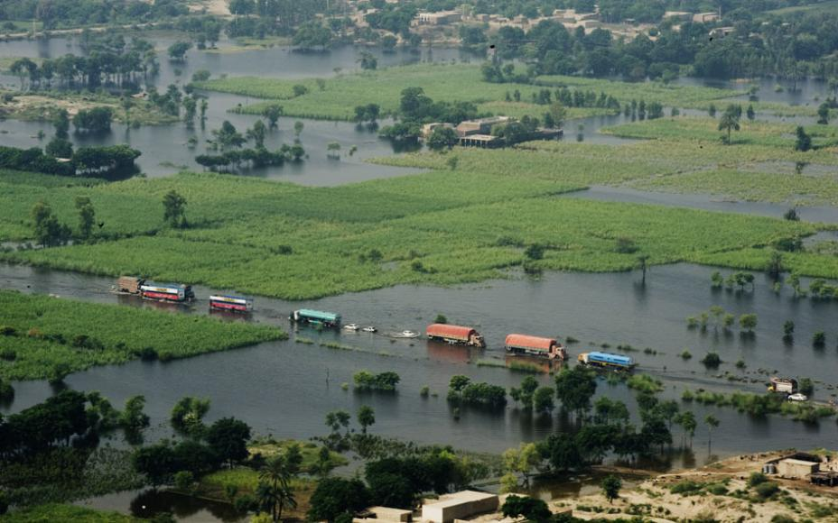
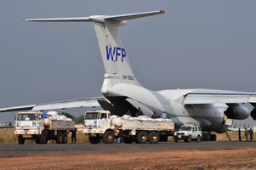
Logistics

Slide 21
WFP Logistics (2014)
Logistics Division – USD 974.2 millions
In 2015, logistics handled 2.2 million metric tons of food
WFP is the UN Cluster lead for Logistics
*Air: cost cover the transport of food, passengers and misc.
** Like: Equipment, Utilities, Supplies, Materials, and Other Related Products
Land | USD 400.2 m
Ocean | USD 148.1 m
Air* | USD 260.9 m
Other transport related costs ** | USD 165.0 m
TOTAL | USD 974.2 m

Slide 22
How to do business with WFP?
Understand WFP’S Requirements
Promote your products
Participate to WFP tenders
Register on UNGM and
In-tend
Check out the document “how to do business with WFP” on www.wfp.org
Understanding WFP’s G&S requirements
Send a presentation of your products to WFP.
Register on www.ungm.org to be in the Vendor lists of all UN
Register on https://ungm.in-tend.co.uk/wfp/aspx/Home to be ready if selected for a WFP tender
Participate to WFP tenders when invited

Slide 23
Requirements to Contract with WFP
Goods and services are of interest to WFP
Legal capacity to enter into a contract with WFP
Has the financial standing to honor a contract
Has proven ability to perform
Company has a minimum of three years’ experience as an established business
Company accepts WFP’s general terms and conditions, including its payment terms

Slide 24
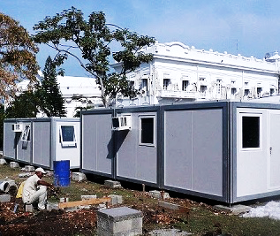
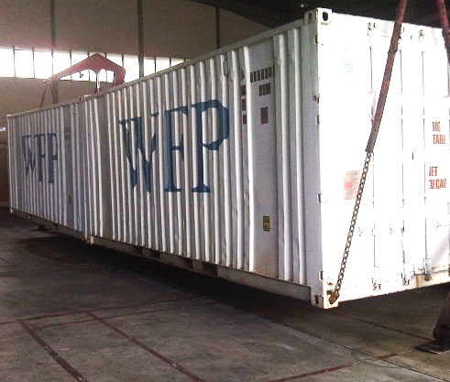
World Food Programme
Via C. G. Viola 68/70
00148 Rome, Italy
Edmondo Perrone
Vendor Management Officer
Email: edmondo.perrone@wfp.org
Francesco Giusso
Chief, Goods & Services
Procurement Division
Email: Francesco.giusso@wfp.org

